Slide 1

Bansilal Ramnath Agarwal Charitable Trust’s
Vishwakarma Institute Of Information Technology ,Pune
Hotel Reservation System
By
Abhishek Supsande
Ajay Patil
Mayur Thakane
Amit Jindam
Sanket More

Slide 2
INTRODUCTION
“ HOTEL RESERVATION SYSTEM ” is an idea to computerize the various functionalities of management at hotel. The main objective of this project is to avoid lot of paper work during the whole year.
Finding an accommodation or a hotel after having reached a particular destination is quite time consuming as well as expensive. Here comes the importance of online hotel booking facility. Online hotel booking is one of the latest techniques in the arena of internet that allows travellers to book a hotel located anywhere in the world and that too according to your tastes and preferences.
The birth of internet made the process of booking a room more easy for your business trip, vacation or weekend getaway. Online hotel bookings help you to plan your vacation or business trip easier and more affordable.

Slide 3
ABSTRACT
“ Hotel Reservation System ” is an idea to help the travellers to get all the information about Rooms, Prices, room’s availability, food and other necessary information for hotel room booking .This project helps the users to carry this task online easily.
1) Economical
2) Technical
3) Operational
Deliverable/ Functional Specification:-
1. Getting Number of users
2. Storing the information about the number of members
3. Enquiry about the Food/ Availability of rooms

Slide 4
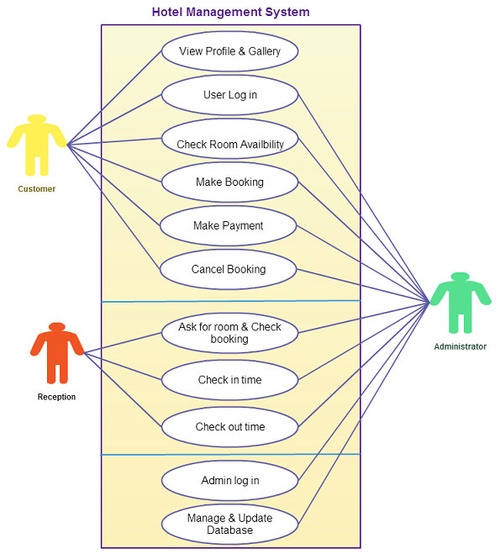
Use - case DIAGRAM

Slide 5
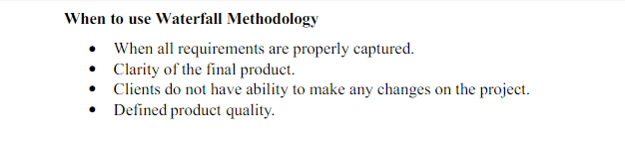
PROCESS MODEL
Waterfall model:-
Waterfall model method is used in our software development project, this divided into sequential phases where “Each phase must be completed before the next phase can begin”. And this method is used because it shows the flow of project process in logical form. The cost of the project can be estimated once all requirements are gathered and defined.
.

Slide 6
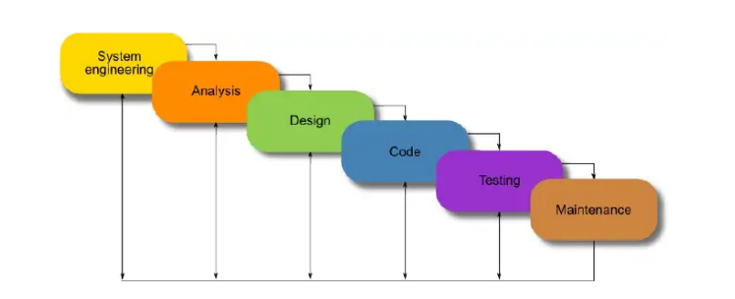

Slide 7
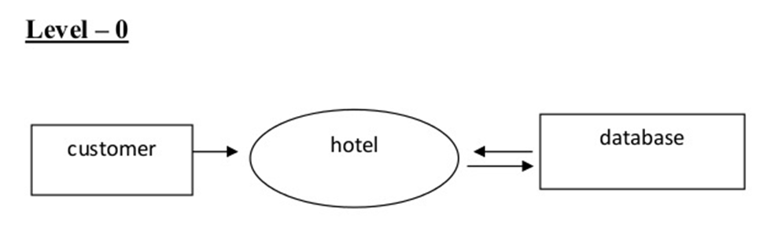
DATA FLOW DIAGRAM

Slide 8
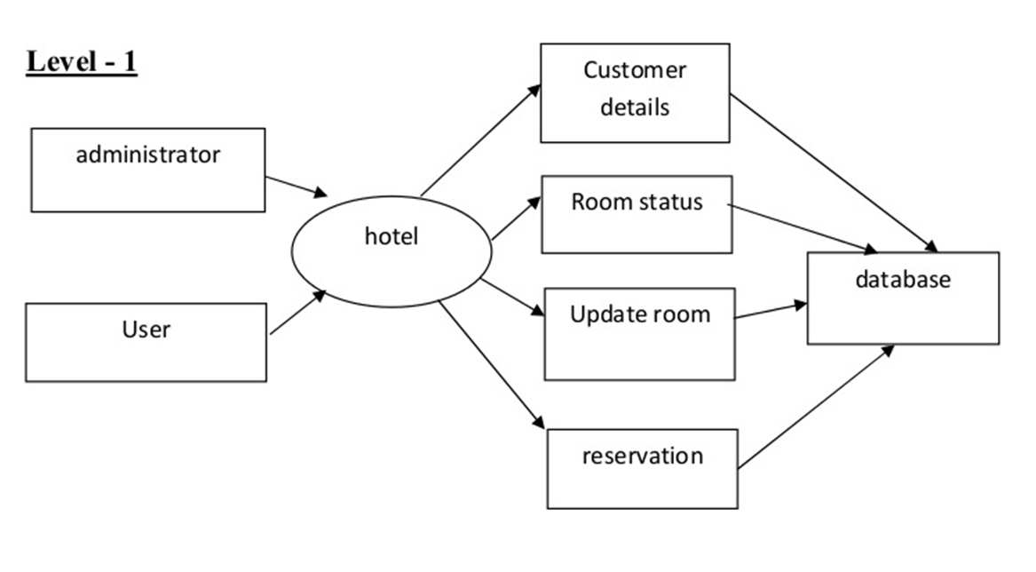

Slide 9
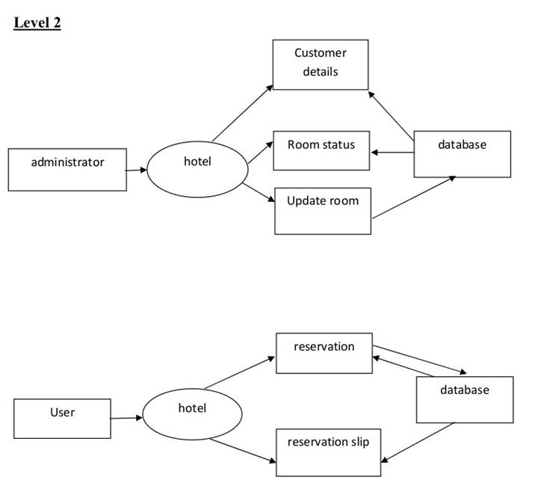

Slide 10
CONCLUSION
The system was found feasible and operational.
The User found the system to be interesting and very easy to handle ,apart from the fact that its accurate and efficient.
The system maintained the required information with all the validations and thus implements data consistency throughout.
This system also provides reports to each level of hierarchy.
The system carries it work from the point of view of administrator as well as the point of customers of the hotel.
The valid inputs are required which can yield the best results. Unauthorised user will not be able to access the system. Thus the system gives its result properly.

Slide 11
THANK YOU

